Slide 1
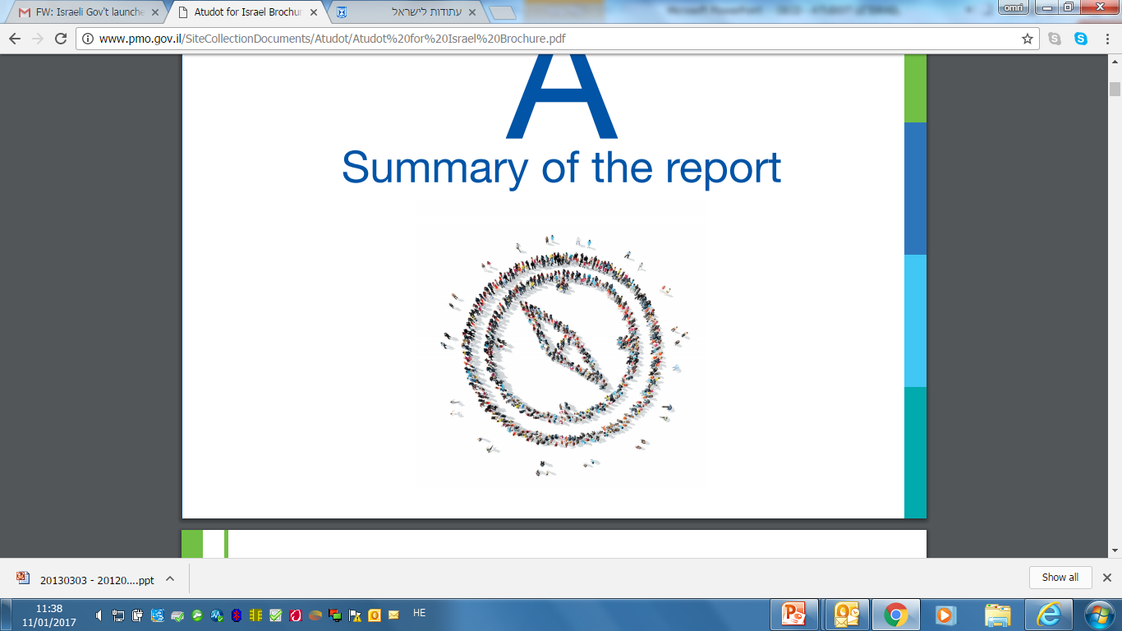
Using Evidence Based HRM and Strategic Planning to Enhance Participation of Under Represented Groups
Iris Nehemia
Strategic Planning Department Director

Slide 2


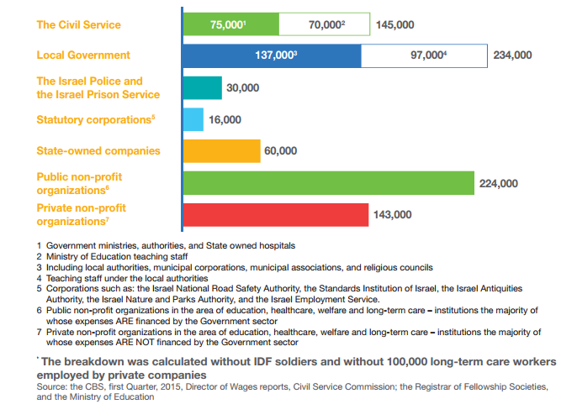
Organizational Breakdown

Slide 3
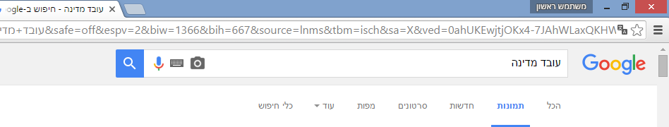
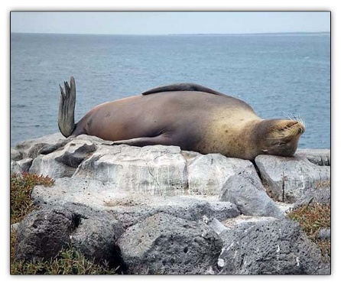

Anecdote
Government employee

Slide 4
How are we perceived?
Which attribute is typical of the public sector ?
Fast
Quality and courtesy
Annoying
Poor quality
Slow
88% negative attributes
Public survey – May 2013
Prime Minister’s Office

Slide 5
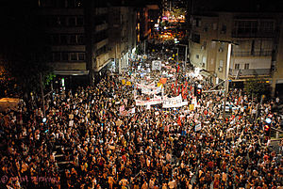

Background to the Reform
We didn’t meet the public needs
Summer 2011
“social justice” protests
The point at which the public looses their trust in the government and it’s administration, mixed with a high-level of uncertainty about the future -
a point of a threat to the state’s stability and future

Slide 6


Our challenge
The World Changes Continuously
Needs
Matching capabilities
Public
Civil Service
The Civil Service is in stagnation
To improve the civil service, and to limit the gap between the rate of change in public needs and the rate of matching capabilities in human capital and organizational infrastructure of the civil service

Slide 7
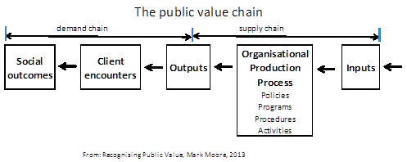
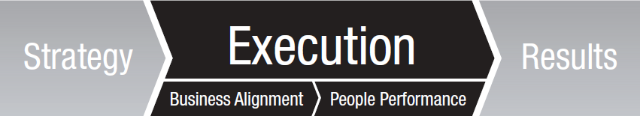
The Basic idea of the reform

Slide 8

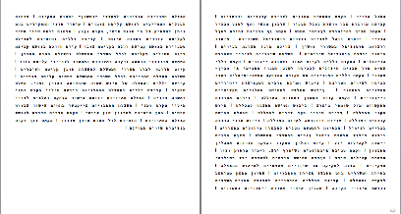

Introduction
The reform – in a nutshell…

Slide 9














Fields of action
Delegation of authority
minimizing internal bureaucracy
Senior management
Recruiting
Ethics and values
Recruiting
Leverage employee’s potential
Training and learning
Leverage employee’s potential
Annual planning
Innovation
platform
Annual planning
Annual feedback and performance evaluation
Strengthening HR subunits
Knowledge Management
Strategic planning

Slide 10
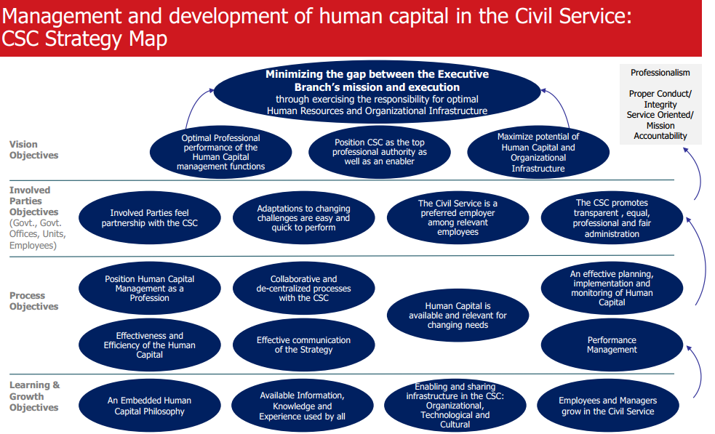
A Strategic map
The map reflects the wanted outcomes of our efforts

Slide 11
Yearly cycle of Planning
Civil Service Commission
December
Vote on State Budget Law
January-April
HR Ministries data analysis
November
Use of Organizational Diagnostic Tools
September- October
Ministry HR work plan
May
HR National assessment
August
Government Budget discussions
June-July
Planning guidelines

Slide 12
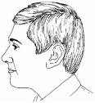
Employee portfolio
Employee details& Data | Assessment center
evaluation Professional officer | Performance appraisal
Employee Attitudes Survey | Customer Evaluation
Summery
The employee has good cognitive abilities. Able to learn new topics and present his views clearly. Performing well under pressure, committed, loyal and dedicated to his work
education
Seniority
Track Positions.......
.......
planning
Professional Level
success
Management
organization
Human relations
availability
engagement
Internal communication
service
trust

Slide 13





Strategic Issues in focus
The changing mix of professions
The aging population
Workforce diversity in the civil service
ICT as a strategic resource for HR management
Fostering the approach of “citizen as a client and as a partner”

Slide 14

The diversity Vision
The Israeli civil service will be a role model for employers in the 21st century of an inclusive HRM in a way that reflects Israel's rich social mosaic
Notes:
Moving away from affirmative action, into inclusive growth:
1. Conceptual-cultural change: inclusion as a professional opportunity that is a benefit for the organization, contrary to the concept of "doing a favor" of affirmative action.
2. Proactive activity of government ministries: locating, sorting, training and promoting diverse populations.

Slide 15





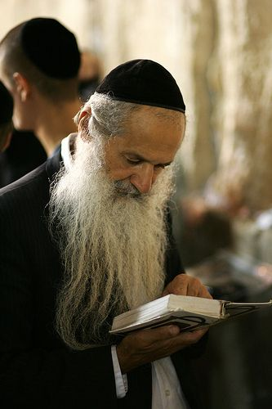
Israeli groups underrepresentation
Arabs
Ethiopians
New immigrants
10.1%
1.87%
1.9%
Women in senior level
People with disabilities
Ultra orthodox Jews
43%
2.8%
NN
Notes:
In Israel there are 5 target populations for which diversity goals have been set:
1. Members of the Ethiopian community
2. people with disabilities
3. Arabs (including Christians and Druze)
4. ultra-Orthodox Jews
5. new immigrants
Of these populations, in 2017, it was decided to focus on people with disabilities due to failure to meet the target set (as opposed to the other populations in focus), and the many entry challenges that this population has when entering the civil service - both from the state as an employer and from the population.

Slide 16
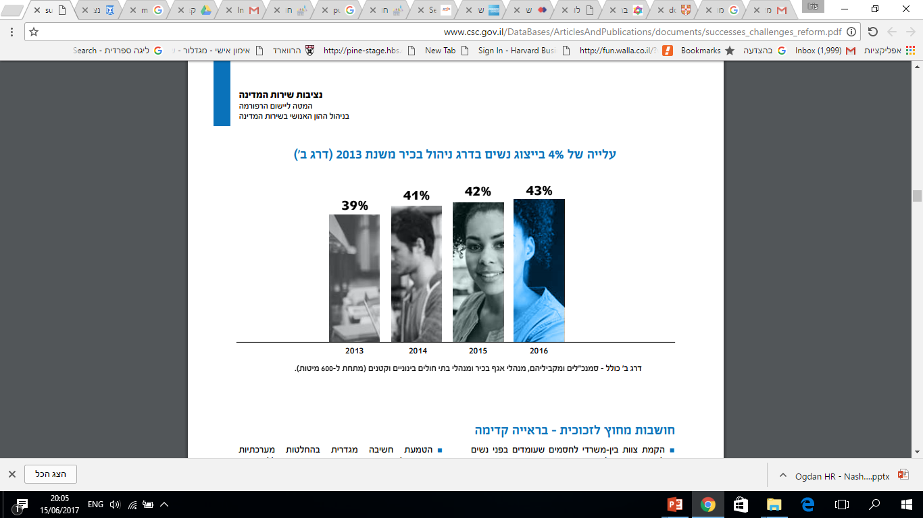
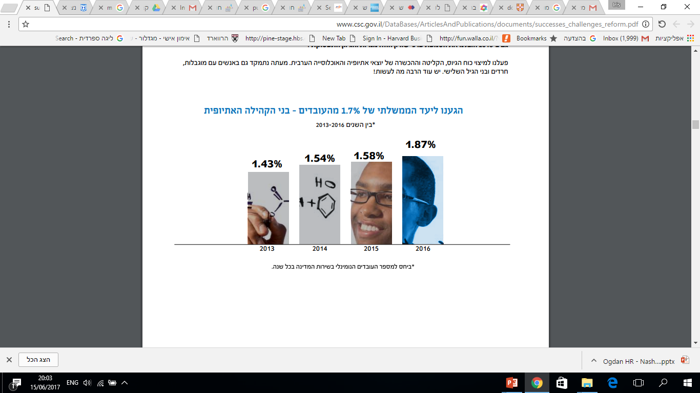
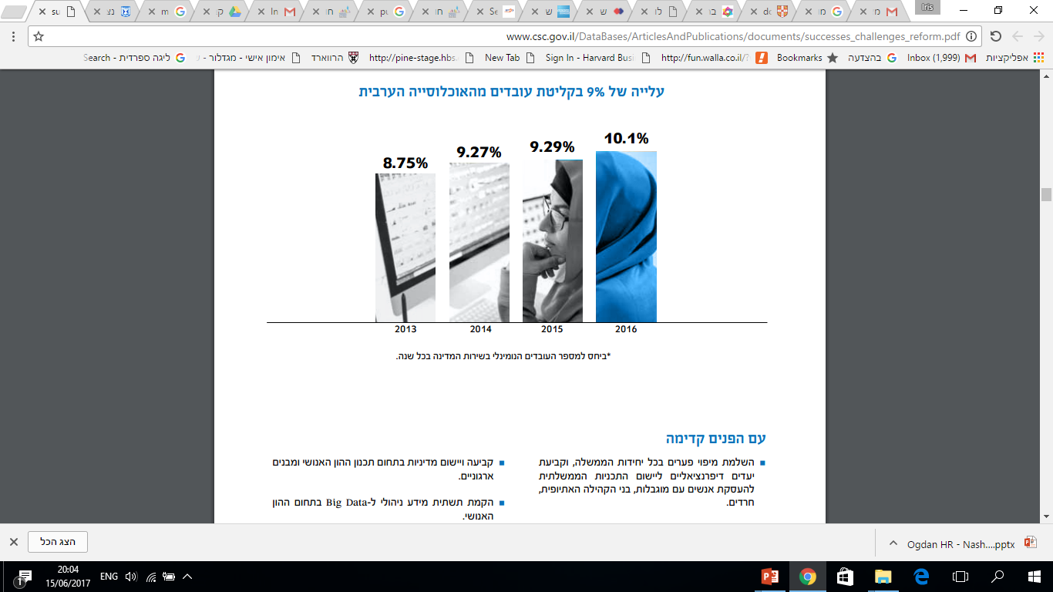
Some results For Example: increasing Diversity
Woman in senior positions
(Target 50%)
Ethiopian employees (Target 1.7%)
Arab employees
(Target 10%)

Slide 17



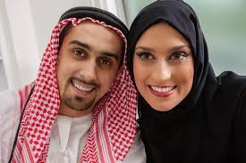

The point of change
Senior
level
Mid-high
level
mid-low
level
Low level

Slide 18
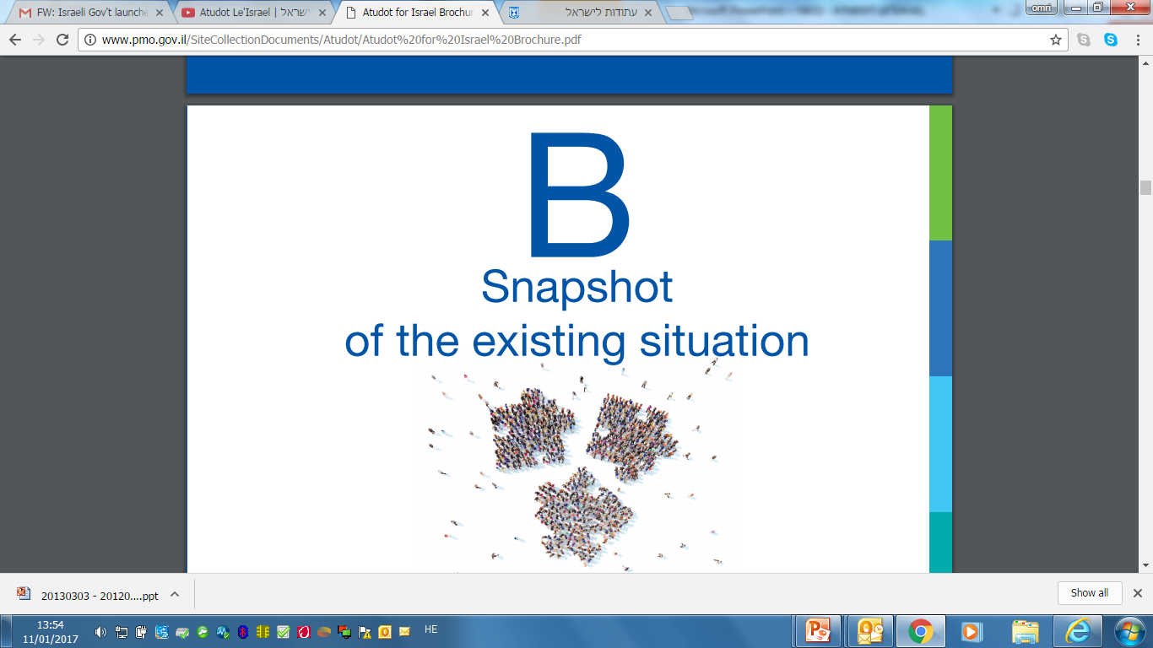
Horizontal Activities (example)
Central committee (CSC with stakeholders) allocate open jobs to target population
Appointment of Head occupational diversity manager in each ministry
Cadet programs must reflect proportional representation of all groups
Special adjustments in entry exams, matching positions (for example: job sharing)
Communicate with a political rank, NGOs &
A pool of diverse employees to accompany the entry process
Building a profile of future civil servants and we take groups of students that could be potential employees.
social media networking activity for recruitment
Deep Examination of survey results: satisfaction, wages and related conditions
Notes:
(

Slide 19
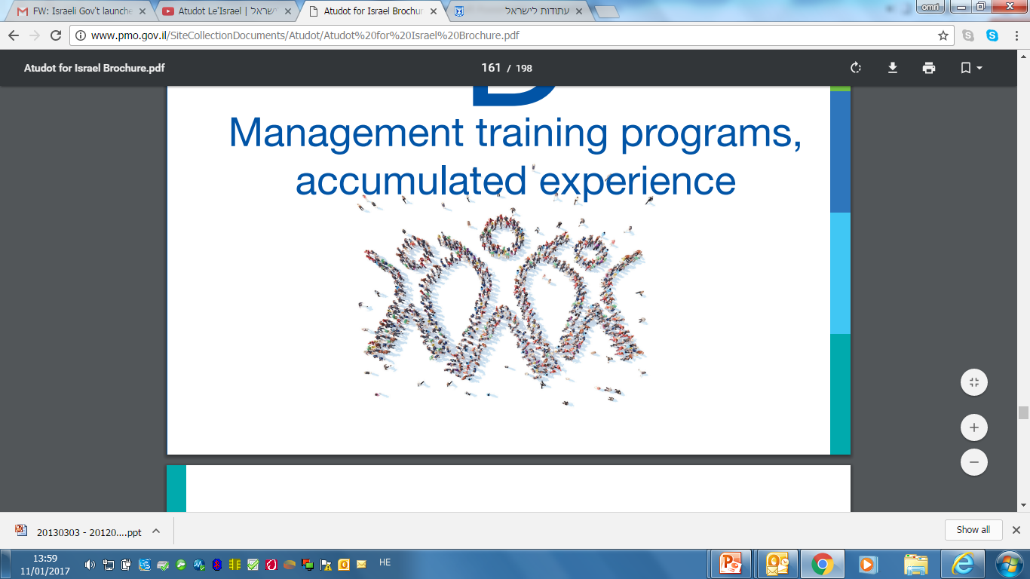
Thank you very much

Slide 20

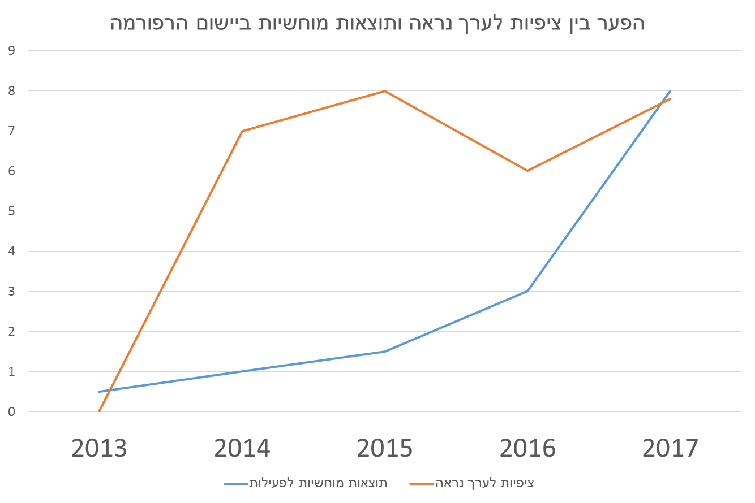

The gap between expectations and seen valuable outcomes
self-sufficiency of the ministries in organizational changes and defining job criteria
High expectations for quick wins
In January 2016 the reform implementation expended to 38 ministries and government units
Differential Employee evaluation
In January 2015 the reform implementation expended to 23 ministries
Long term efforts
In June 2013 the reform implementation has started in 6 ministries
seen valuable outcomes
Expectations for valuable outcomes
Notes:
מסרים עיקריים:
התהוות נציבות חדשה מהווה מהלך קריטי לצורך תכנון כ"א והגשמת יעדי הרפורמה
משך תהליך ההתהוות ארוך ==> נדרש ניהול חיצוני בתקופת המעבר

